Slide 1
Overview of BioLUC Data
Ethan Warner
Biofuels Land Use Change Modeling Workshop
Oak Ridge National Laboratory
May 7th, 2013

Slide 2
Overview of BioLUC Data
Primary Data Sources
Model and Data Resolution
Data Processing for Model Use
BioLUC and GTAP Comparison

Slide 3
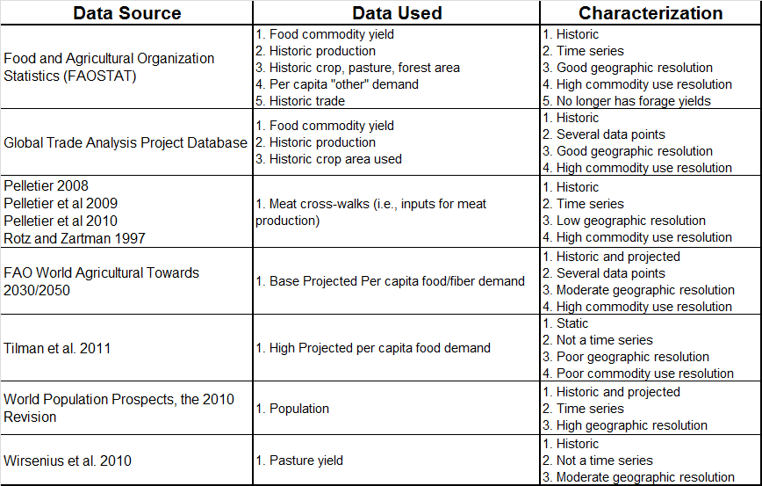
Data Sources
High Food Demand Scenarios
High/Low Pop. Scenarios
Notes:
Green – Important data inputs
Orange – Less important inputs
Red – Highlighted weaknesses

Slide 4
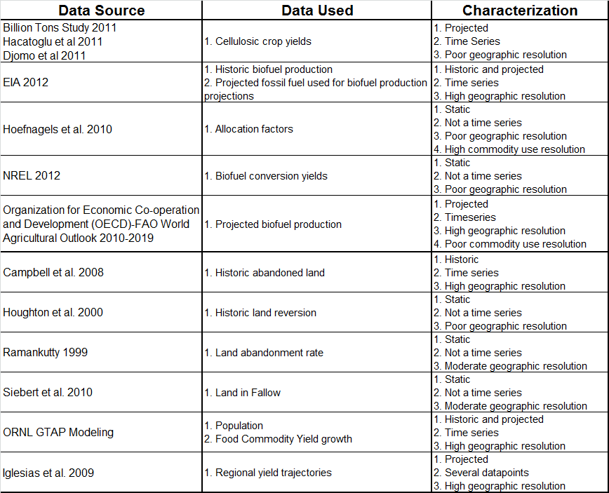
Data Sources Cont.
Multiple Alternative Biofuel Demand Scenarios
GTAP and High Yield
Scenarios
Climate Change
Scenario

Slide 5
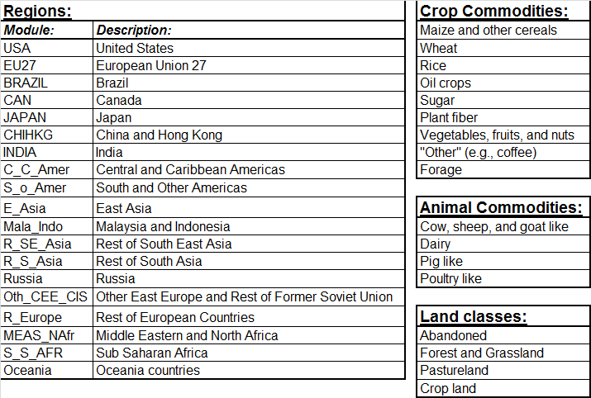
BioLUC Model Input Resolution
Notes:
19 regions:
- The model us modular so the model can be modified to more or fewer region.
19 regions is the highest resolution spatial data that we use.
Commodity Crops:
-While the items circled use land, they are not major drivers of
-They are included mostly for accounting purposes
Animal Commodities:
-Inputs for these meat products are not largely dissimilar so these could theoretically be merged.
Land Classes:
-Relative to other land classes, abandoned land is small in quantity. This category functions more as a leakage category for cropland.
-Cropland is a general category and then a category divided out into the crop category classes.

Slide 6
Data Processing
Data Source Processing Data Merging Processing BioLUC Input
FAO Per capita “other” demand
Aggregation - Country
Per capita commodity demands
Forecasting
Per capita commodity demands
Projected per capita food and fiber demand
Regional Proxies
No Change
Historic biofuel production
Projected biofuel production (to 2019)
Aggregation - Country
Biofuel demand
Cellulosic crop yields
Forecasting
Biofuel demand
Biomass conversion yields
Allocation factors
Projected fossil fuel use
No Change
GTAP production
FAO food balance
Aggregation - Country
Aggregation - Commodity
Milling factors
Milling factors
FAO Crop, pasture and forestland; GTAP Cropland; and Campbell 2008 abandoned land
Land initialization
Land initialization
FAO and GTAP Commodity yield
Forecasting
Commodity yield
Commodity yields
Trade
Land reversion rate
Meat cross-walks
No Change
Trade Initialization
Land reversion rate
Meat cross-walks
Land abandonment rate
Land in fallow
Pastureland yield
Land abandonment
Land in fallow
Pastureland yield
Regional Proxies
Population
Aggregation - Country
Population

Slide 7
Comparison of BioLUC and GTAP Data
Exogenous vs. Endogenous
Explicit vs. Implicit Economic Data
Land Resolution
Accounting of Abandoned and Fallow land
Commodity resolution
Geographic resolution, same by design

Slide 8
Summary
Exogenous Data w/ internal model feedback and stock and flow accounting of agricultural land use
Relative Data Strengths
Population scenarios
Yield scenarios (except pasture)
Baseline demand
Land initializations
Relative Data Weaknesses
Resolution and temporal dimensions of meat cross-walks
Alternative demand scenarios
Non-U.S. future term biofuel assumptions
“Other” Land accounting
Abandoned crop land leakage and reversion
Fallow

Slide 9
Additional Slides

Slide 10
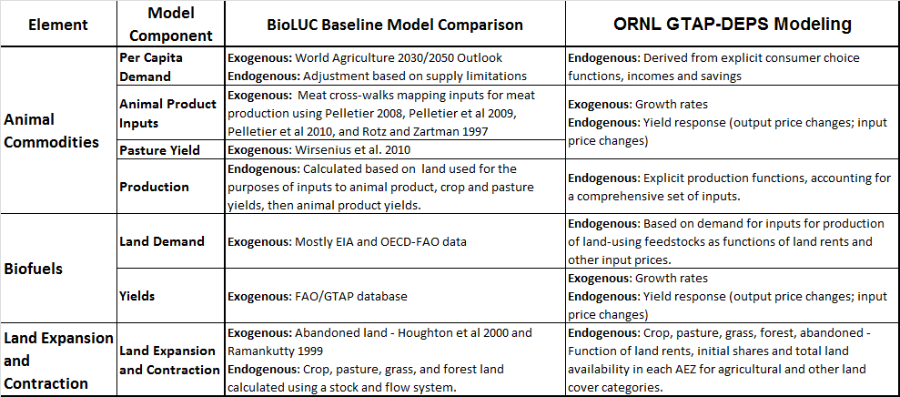
BioLUC and GTAP Data Comparison

Slide 11
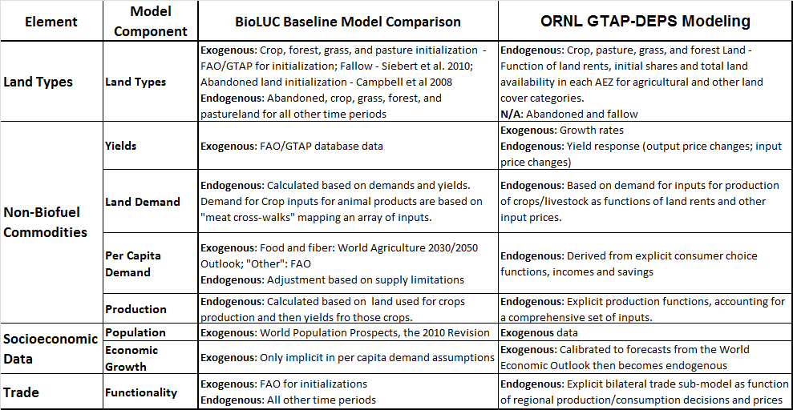
BioLUC and GTAP Data Comparison cont.

